Slide 1
Layered Architecture
Mahesh Shirole
VJTI
Resources:
Software Architecture Patterns by Mark Richards
https://dzone.com/articles/layered-architecture-is-good

Slide 2
Layered Architecture
The most common architecture pattern (N-tier Architecture)
The separation of concerns among components
The de-facto standard for most Java EE applications
Components within the layered architecture pattern are organized into horizontal layers
each layer performing a specific role within the application (e.g., presentation logic or business logic)
The pattern does not specify the number and types of layers that must exist in the pattern

Slide 3
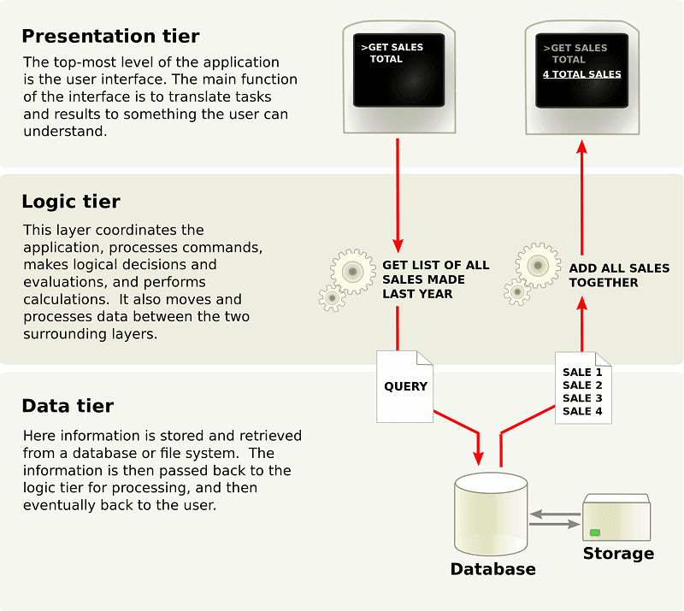

Slide 4
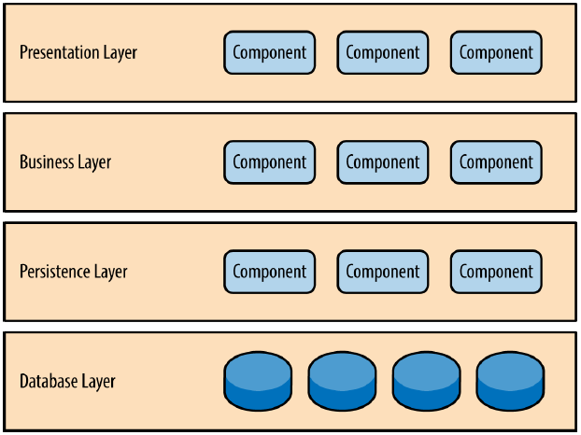
Layered Architecture

Slide 5
Layered Architecture
Each layer in the architecture forms an abstraction around the work that needs to be done to satisfy a particular business request
Presentation layer : responsible for handling all user interface and browser communication logic
Business layer : responsible for executing specific business rules associated with the request
Persistence layer : get the data from the database layer
Database Layer : Store data in the hard disk and provide requested data

Slide 6
Layered Architecture
Components within a specific layer deal only with logic that pertains to that layer
This type of component classification makes it easy to
build effective roles and responsibility models into your architecture
develop, test, govern, and maintain applications using this architecture pattern
Well-defined component interfaces and limited component scope

Slide 7
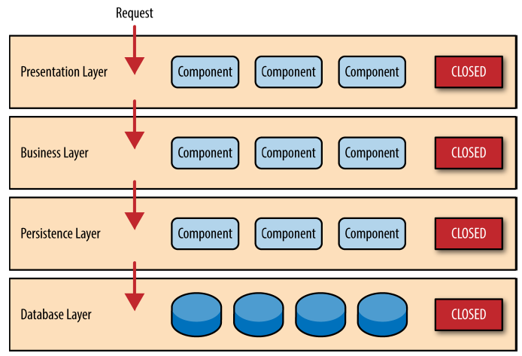
Closed Layer
A closed layer means that as a request moves from layer to layer, it must go through the layer right below it to get to the next layer below that one
For example, a request originating from the presentation layer must
first go through the business layer
then to the persistence layer
finally to the database layer

Slide 8
Closed Layers
Direct database access from the presentation layer is much faster than going through a bunch of unnecessary layers just to retrieve or save database information
Why need of bunch of unnecessary layers?
A key concept is layers of isolation
The layers of isolation concept means that
changes made in one layer of the architecture generally don’t impact or affect components in other layers
the change is isolated to the components within that layer, and possibly another associated layer

Slide 9
Layers of Isolation Concept
The layers of isolation concept also means that
Each layer is independent of the other layers
having little or no knowledge of the inner workings of other layers in the architecture
Example
Consider a large refactoring effort to convert the presentation framework from JSP (Java Server Pages) to JSF (Java Server Faces)
Assuming that the contracts (e.g., model) used between the presentation layer and the business layer remain the same
The business layer is not affected by the refactoring and remains completely independent of the type of user interface framework used by the presentation layer

Slide 10
Add New Layer
Suppose you want to add a shared-services layer to an architecture containing common service components accessed by components within the business layer (e.g., data and string utility classes or auditing and logging classes)
In this example, the new services layer would likely reside below the business layer to indicate that components in this services layer are not accessible from the presentation layer
This presents a new problem
Business layer is now required to go through the services layer to get to the persistence layer, which makes no sense at all

Slide 11
Open Layer
This is resolved by making Service Layer Open
The services layer in this case is marked as open,
requests are allowed to bypass this open layer and go directly to the layer below it
In the example,
The services layer is open
Business layer is now allowed to bypass it and go directly to the persistence layer
This makes perfect sense

Slide 12
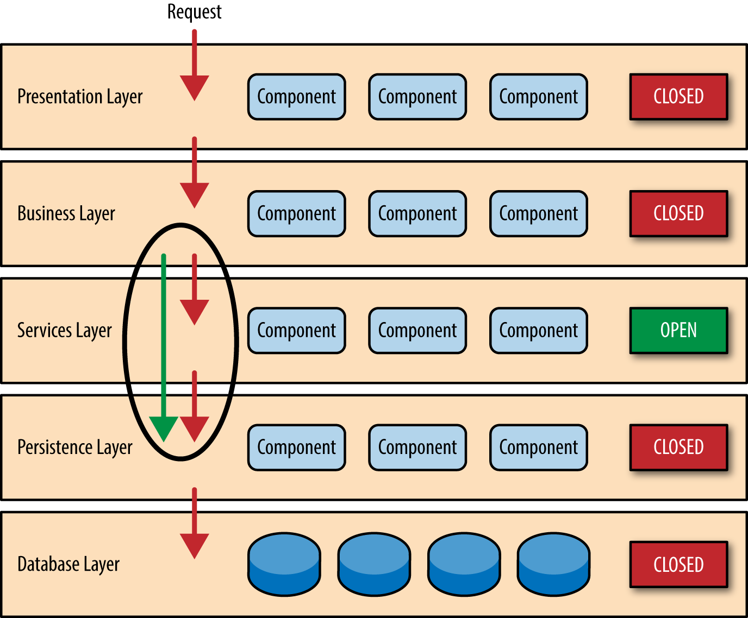
Open Layer

Slide 13
Layered Architecture: Closed + Open Layers
Leveraging the concept of open and closed layers helps
define the relationship between architecture layers and request flows
provides designers and developers with the necessary information to understand the various layer access restrictions within the architecture
Failure to document or properly communicate which layers in the architecture are open and closed (and why)
Results in tightly coupled and brittle architectures
Architectures are very difficult to test, maintain, and deploy

Slide 14
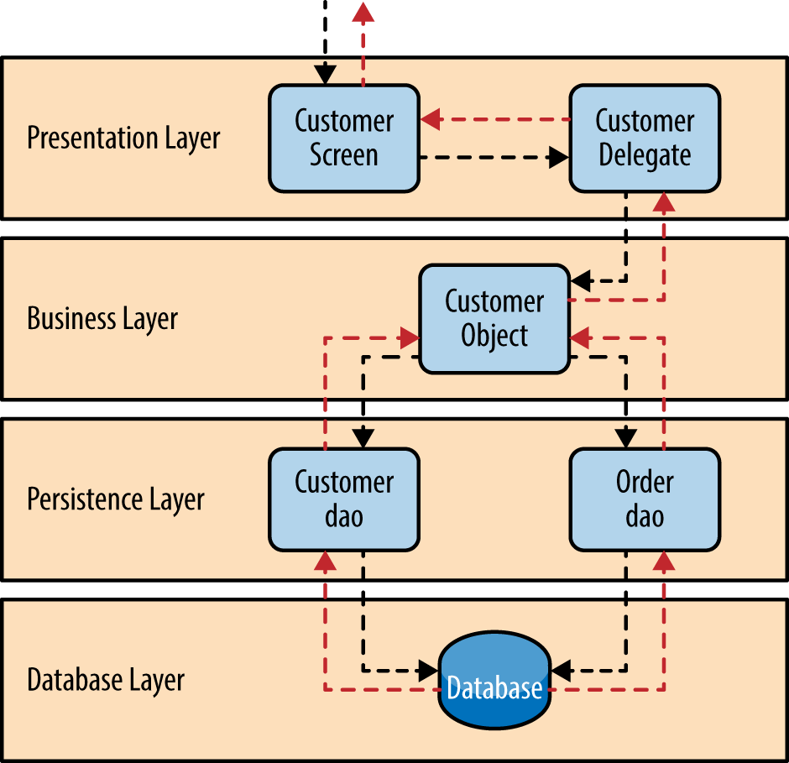
Example

Slide 15
Architecture Sinkhole: Anti-pattern
This anti-pattern describes the situation where
Requests flow through multiple layers of the architecture as simple pass-through processing with little or no logic performed within each layer
Every layered architecture will have at least some scenarios that fall into the architecture sinkhole anti-pattern
Analyze the percentage of requests that fall into this category
The 80-20 rule
Usually a good practice to follow to determine whether or not you are experiencing the architecture sinkhole anti-pattern
20 percent of the requests as simple pass-through processing and 80 percent of the requests having some business logic associated with the request

Slide 16
Pattern Analysis
Characteristics | Rating | Analysis
Overall Agility: the ability to respond quickly to a constantly changing environment | Low | Change can be isolated through the layers of isolation feature of this pattern, it is still cumbersome and time-consuming to make changes in this architecture pattern because of the monolithic nature of most implementations as well as the tight coupling of components
Ease of deployment | Low | Depending on how you implement this pattern, deployment can become an issue, particularly for larger applications. One small change to a component can require a redeployment of the entire application (or a large portion of the application), resulting in deployments that need to be planned, scheduled, and executed during off-hours or on weekends.
Testability | High | Because components belong to specific layers in the architecture, other layers can be mocked or stubbed, making this pattern is relatively easy to test

Slide 17
Pattern Analysis
Characteristics | Rating | Analysis
Performance | Low | The pattern does not lend itself to high-performance applications due to the inefficiencies of having to go through multiple layers of the architecture to fulfil a business request
Scalability | Low | Because of the trend toward tightly coupled and monolithic implementations of this pattern, applications build using this architecture pattern are generally difficult to scale. You can scale a layered architecture by splitting the layers into separate physical deployments or replicating the entire application into multiple nodes
Ease of development | High | Ease of development gets a relatively high score, mostly because this pattern is so well known and is not overly complex to implement. Because most companies develop applications by separating skill sets by layers (presentation, business, database), this pattern becomes a natural choice for most business-application development.

Slide 18
Benefits of a Layered Architecture
Simplicity – the concept is very easy to learn and visible in the project at first grasp
Consistent across different projects – the layers and so the overall code organization is pretty much the same in every layered project
Guaranteed separation of concerns – just the concerns that have a layer and to the point that you stick to the rules of Layered Architecture, but it’s very easy with the code organization it implies
Browsability from a technical perspective – when you want to change something in some/all objects of a given kind, they’re very easy to find and they’re kept all together
Easy to add new features - If you want to introduce a new feature, you can add it to the appropriate tier without affecting the other tiers
More efficient development - N-tier architecture is very friendly for development, as different teams may work on each tier

Slide 19
Drawbacks of a Layered Architecture
No built-in scalability – when the project grows too much, you need to find a key to organizing it further by yourself. The principles of Layered Architecture won’t help you
Hidden use cases – you can’t really say what a project is doing by simply looking at the code organization. You need to at least read the class names and, unfortunately, sometimes even the implementation
Low cohesion – classes that contribute to common scenarios and business concepts are far from each other because the project is organized around separating technical concerns
No dependency inversion – in a classical Layered Architecture, the dependencies are direct and, conceptually, changes from a low-level infrastructure layer can propagate to more important higher layers

Slide 20
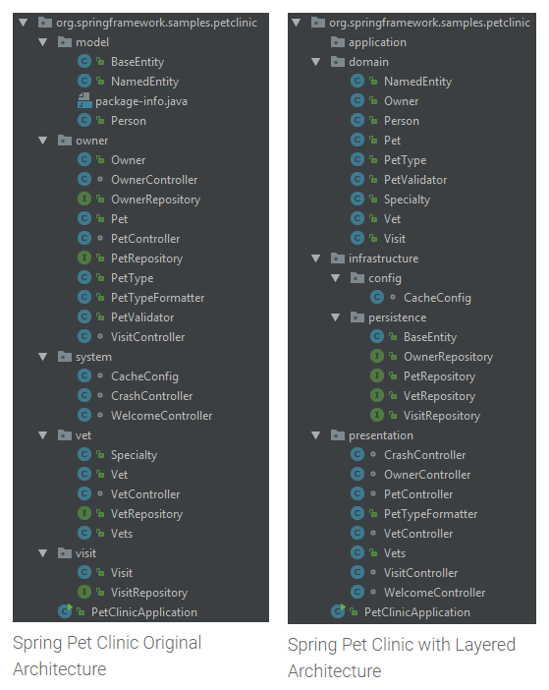

Slide 21
Example Code
https://o7planning.org/en/10285/create-a-simple-java-web-application-using-servlet-jsp-and-jdbc

